Slide 1

Market Intelligence Report
US Data Role
Job Market Analysis
Comprehensive insights into salaries, skills, and market trends across data professions
2024 Analysis
742 Job Opportunities
343 Companies

Slide 2
Navigation
Executive Overview
01
Market Snapshot
02
Salary Analysis
Key metrics and market overview including job volume, company participation, and salary benchmarks
Deep dive into compensation patterns, salary ranges, and high-paying role identification
03
Skill Demand Patterns
04
Company Landscape
Technical competency requirements across roles including Python, SQL, Excel, and cloud technologies
Job distribution analysis across company revenue tiers and organizational characteristics
Strategic Focus: Data-driven insights for career planning, hiring strategies, and skill development decisions

Slide 3
Market Overview
Market at a Glance
Comprehensive snapshot of the US data role job market in 2024
742
343
464
Total Jobs
Hiring Companies
Distinct Job Titles
Active opportunities
Organizations recruiting
Role variations
$101.48K
$254.00K
$15.50K
Average Salary
Highest Salary
Lowest Salary
Market benchmark
Top compensation
Entry-level range
Data Scope: Analysis covers data roles across all industries in the United States for 2024, including Data Scientists, Data Analysts, Data Engineers, Machine Learning Engineers, and related positions.

Slide 4

Chapter 01
Salary
Analysis
Deep dive into compensation patterns across data roles, revealing salary hierarchies, range distributions, and high-paying opportunities
$101.48K
$238.5K
Average Salary
Salary Range

Slide 5
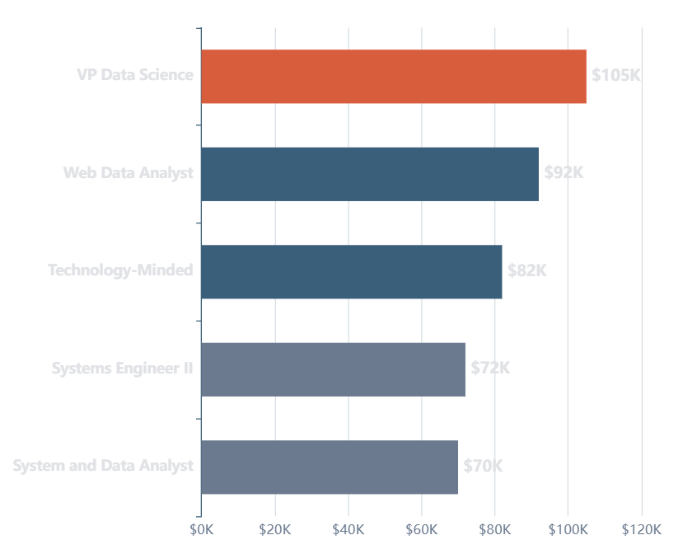
Compensation Insights
Average Salary by Role
Leadership and specialized roles command premium compensation
1
VP Data Science
~$100K+
Executive leadership role commanding the highest compensation in the data field, reflecting strategic decision-making responsibilities
2
Web Data Analyst
~$90K+
Specialized analytics role focused on web metrics and digital performance optimization
3
Tech-Minded Roles
~$80K+
Technical positions requiring strong engineering and development skills

Slide 6
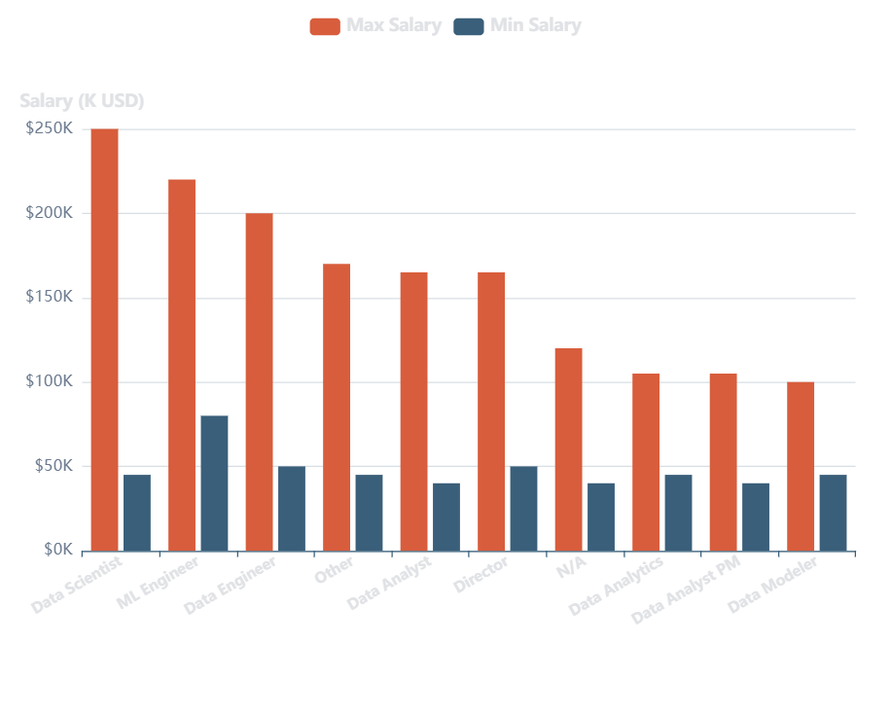
Compensation Variance
Salary Range Distribution
Understanding the spread between minimum and maximum compensation across role categories
Key Insights
Data Scientists show the widest salary range, indicating significant variation based on experience and specialization
Machine Learning Engineers demonstrate strong upper bounds, reflecting high demand for AI/ML expertise
Data Analysts have more compressed ranges, suggesting standardized entry-to-mid level compensation
Strategic Implications
Largest Range
Data Scientist
High variance = growth potential
Most Stable
Data Analyst
Predictable career progression

Slide 7
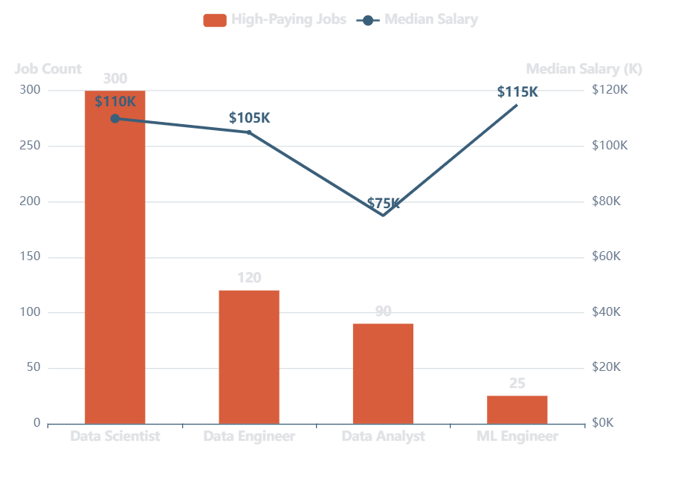
Opportunity Analysis
High-Paying Roles vs Market Volume
Balancing compensation potential with job availability across data professions
Market Leaders
Data Scientist
~300
High-paying jobs
$110K+ median salary
Data Engineer
~120
High-paying jobs
$105K+ median salary
Volume vs Value
Data Scientists offer the best combination of high volume and premium compensation
Data Analysts provide the highest job volume with moderate compensation
ML Engineers show premium pay but limited high-paying opportunities

Slide 8

Chapter 02
Skill Demand
Analysis
Understanding the technical competencies driving the market and the skills that command premium opportunities
392
380
Python Demand
SQL Demand

Slide 9
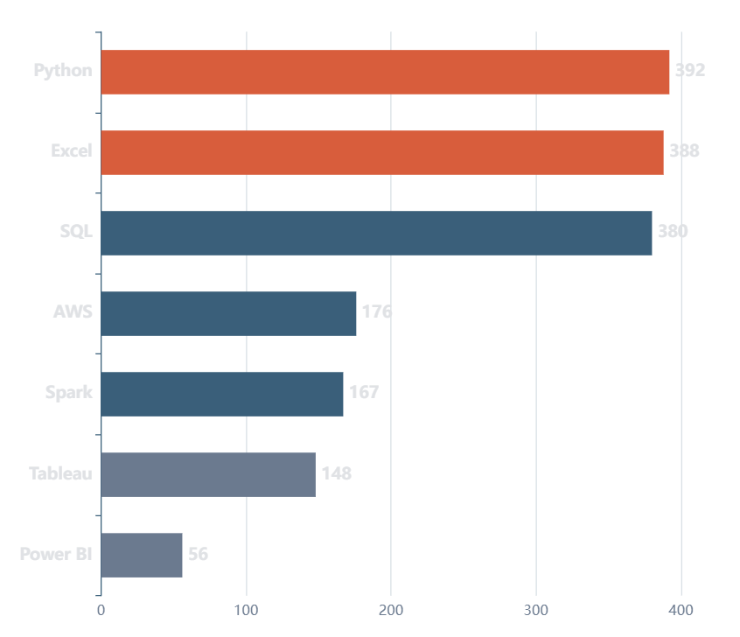
Technical Competencies
Core Skills Overview
Most in-demand technical skills across all data roles
Top 3 Skills
1
Python
100%
392 job mentions
2
Excel
99%
388 job mentions
3
SQL
97%
380 job mentions
Skill Categories
Programming
Analytics
Python, SQL
Excel, Tableau
Cloud
Visualization
AWS, Spark
Power BI

Slide 10
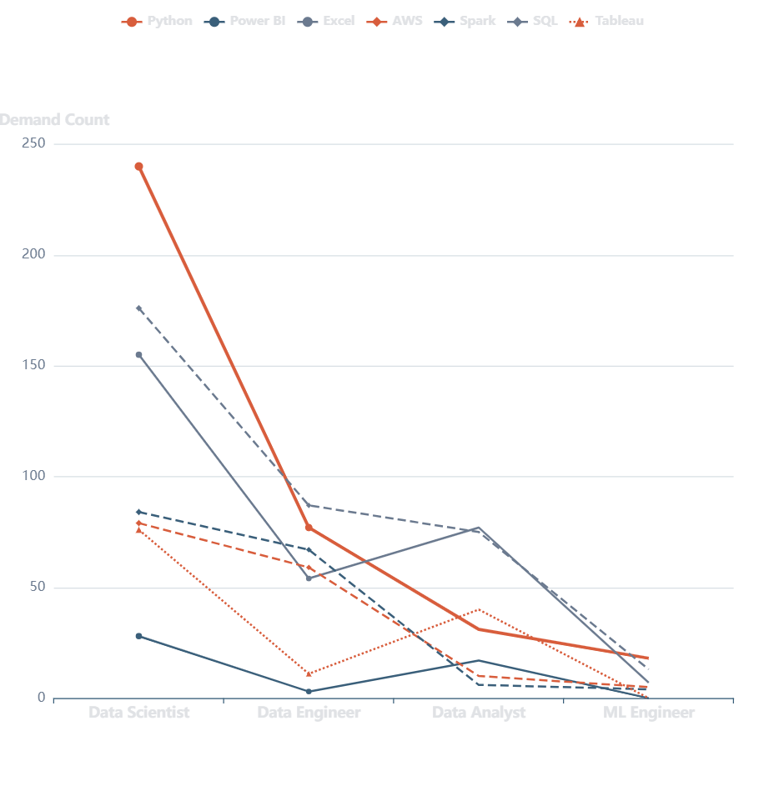
Role-Specific Requirements
Skill Demand by Role
Technical competency patterns across different data professions
Data Scientist
Python
240
SQL
176
Excel
155
Heavy emphasis on Python and statistical programming
Data Engineer
SQL
87
Python
77
AWS
59
Strong database and cloud infrastructure focus
Data Analyst
Excel
77
SQL
75
Tableau
40
Excel and visualization tools are essential

Slide 11
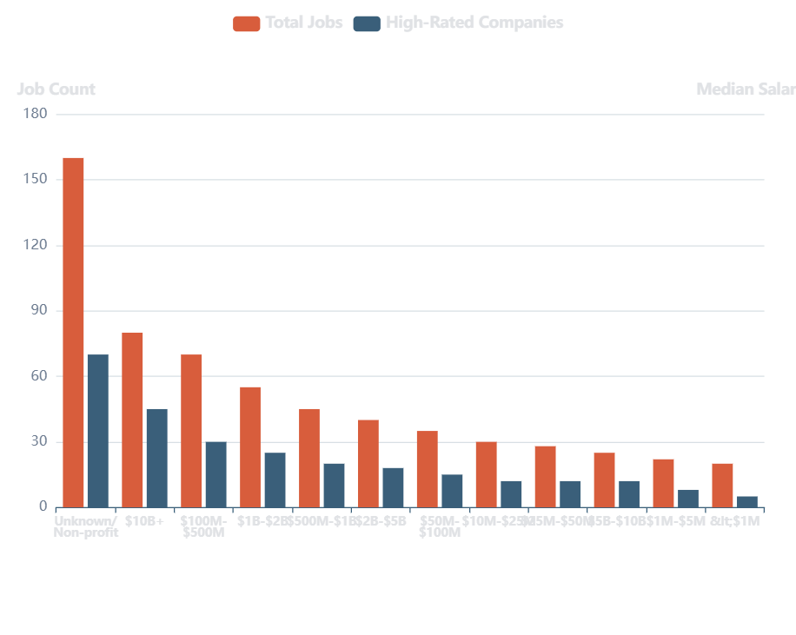
Organizational Landscape
Company Revenue Distribution
Job opportunities across different company sizes and revenue tiers
Key Findings
Unknown/Non-profit sector offers the most opportunities (~160 jobs), indicating strong demand in research and mission-driven organizations
Large enterprises ($10B+) provide ~80 high-quality positions with competitive compensation packages
Mid-market companies ($100M-$500M) show strong hiring activity with ~70 opportunities
High-Rated Companies
Total Jobs
High-Rated
742
~180
24% of jobs are in top-tier companies
Best Segments for Quality
$10B+
$1-2B
$500M-1B

Slide 12
Conclusion
Strategic Insights
Salary Leadership
Volume Opportunities
Data Scientists command the highest salaries with an average of $110K+, but require advanced Python and machine learning expertise.
Data Analysts offer the highest job volume with ~400+ positions, making it an excellent entry point into the data field.
Leadership roles like VP Data Science can exceed $100K+, demonstrating the value of strategic data leadership.
Strong foundation in Excel and SQL opens doors to 70+ unique job roles across industries.
Skill Priorities
Market Outlook
Python, Excel, and SQL form the essential trinity, appearing in 97-100% of job postings.
With $101.48K average salary across 742 opportunities from 343 companies, the data job market demonstrates robust demand.
Cloud skills (AWS, Spark) are increasingly important, especially for Data Engineers seeking premium compensation.
Diverse opportunities exist across company sizes, from startups to Fortune 500 enterprises.
Ready to Advance Your Data Career?
Leverage these insights for strategic career planning, skill development, and job search prioritization

